Slide 1
Welcome to EMBL-EBI & Cancer Genomics 2018
sarahm@ebi.ac.uk
www.ebi.ac.uk/training

Slide 2
Welcome to EMBL-EBI
Contacts
Training Team – courses@ebi.ac.uk
Registration Desk – 8553
Emergency – 3333
Course organiser and events team
Sarah Morgan – sarahm@ebi.ac.uk
Johanna Langrish – johanna@ebi.ac.uk

Slide 3
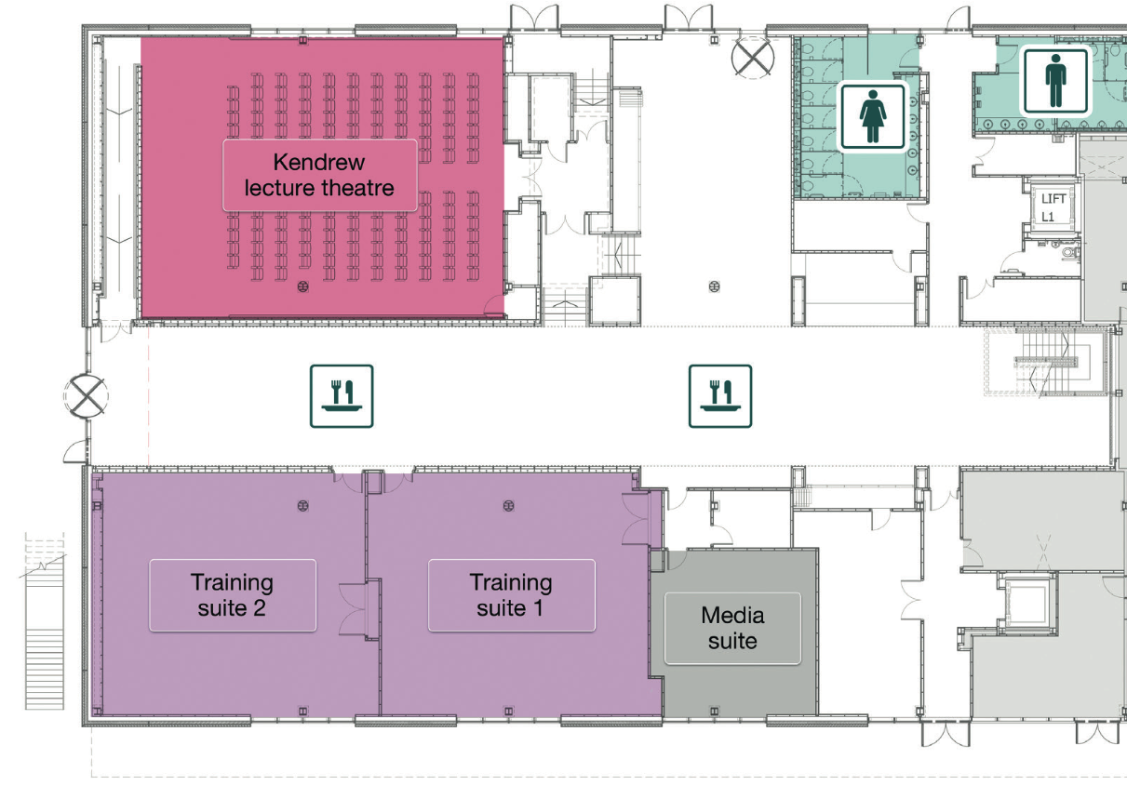
Registration desk

Slide 4

EXIT
EXIT
EXIT
EXIT
EXIT

Slide 5
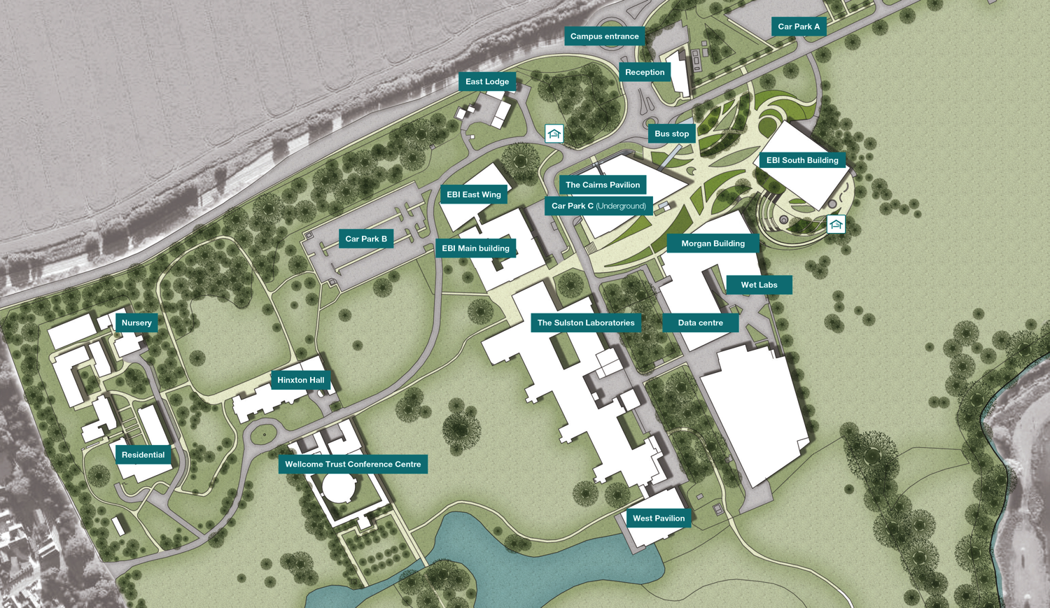
Fire Assembly: Car Park A

Slide 6

Breaks and lunch
Refreshments will be served outside the room
Food will be labeled for dietary needs
Don’t bring food or drinks in to the room

Slide 7

Please remember
We may take photographs during the course
These will be used for promotional materials
They may be shared via social media
Let us know if you do not wish to appear in them

Slide 8




Training room
Notes:
No food or drink in the room
This is a non-smoking campus
Turn your phone off
Avoid checking emails or social media during talks!

Slide 9
Computer workstation – things to note
USB flash drives work in Windows, not LINUX
Avoid connecting USB hard drives or mobile phones
Don’t connect to a VPN
Don’t close the LINUX connection session

Slide 10
Social Media
@EBItraining
Training news and events
@EMBLEBI
Institute news and research
facebook.com/EMBLEBI
Events, pictures, and news

Slide 11
Cancer Genomics 2018

Slide 12
Course aims and outcomes
This course focuses on the analysis of data from genomic studies of Cancer. It provides an insight into the bioinformatic concepts required to analyze such data, and practical sessions will enable participants to apply statistical methods to the analysis of cancer genomics data.
Learning outcomes:
Evaluate the applications and challenges of HTS in the study of cancer genomics
Detect, visualise and annotate copy number variation
Interpret complex genomic rearrangements such as structural variants
Indicate the principles of tumour purity, heterogeneity and evolution and how these influence/impact upon bioinformatics analysis
Perform alignment and quantification of expression of RNA-seq datasets
Explore network deregulation in cancer

Slide 13
Programme
Link to programme
Monday – SNV analysis; variant annotation and filtration
Tuesday – SV analysis; CNV analysis
Wednesday – Data visualisation; RNA-Seq analysis
Thursday – CRISPR-Cas9 editing for cancer dependencies; Cancer genomics in the cloud

Slide 14
Enjoy the course!

